Slide 1

Pivotal Cloud Foundry Administrator
Presenter
Anil Bidari,
Founder and CEO Cloud Enabled
Email : anil.bidari@thecloudenabled.com

Slide 2

Introduction to the Course
Introduction to PCF
Deploy App
(Logging, Scaling, HA)
Blue Green Deployment
Services
AWS Stack creation
Install Ops Manager
Install Elastic Runtime
Install Ops Director
Copyright Cloud Enabled 2017 , All rights Reserved. https://training.thecloudenabled.com

Slide 3
Introduction to the Course
Login to Apps Manager
Orgs, Spaces,Roles
Deploy App to your PCF
Quotas
Build packs and Bosh troubleshooting
Bosh release and deploy
Upgrade your PCF installation
Backup and restore PCF
Copyright Cloud Enabled 2017 , All rights Reserved. https://training.thecloudenabled.com

Slide 4

PCF Overview ?

Slide 5






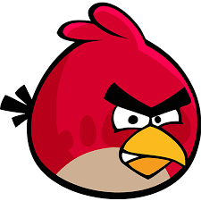




Before PCF
Ok…
Which JDK to use ?
Ok…
Which Build tool to use ?
Ok…
Which tomcat version to use ?
Ok…
Deploying….
Ok…
Which OS you want me to deploy on?
I Have an App
Please deploy it for me ?
Something went wrong
It is Java App
Any Latest Win/Linux OS
is ok for me
JDK 8
Maven
Tomcat 7
Ok…
What App is it ?
Developer cum Boyfriend
IT operations cum
Girl-friend

Slide 6

After PCF
Hey Honey …!
Deploy my app
Sure Baby.. Deployed ☺
Here is your app url☺
Developer cum Boyfriend
Cloud foundry
Cum
Wife ;)

Slide 7

PCF – Moral of Story
So Get Married – don’t have affairs ☺

Slide 8
Cloud Foundry - Overview
Cf push
(a command is all takes to deploy your app )
Eliminate complexity of deploying apps
Open Source Platform
( Can deploy on AWS,Azure ,Openstack ,Vsphere, GCP )
Deploy your Apps
( with no code modification)

Slide 9

CF Push

Slide 10
CF Command Line
(Send create app request )
Cloud Controller
Database server
Cf push
Stores App metadata
Upload
files
App Start
Store App files
Cloud Controller
Cloud Controller
Blob Store
Report Staging
Complete
Start and report
App Status
Stage App
Developer
Store App Droplet
Diego Cell
Stream staging output

Slide 11
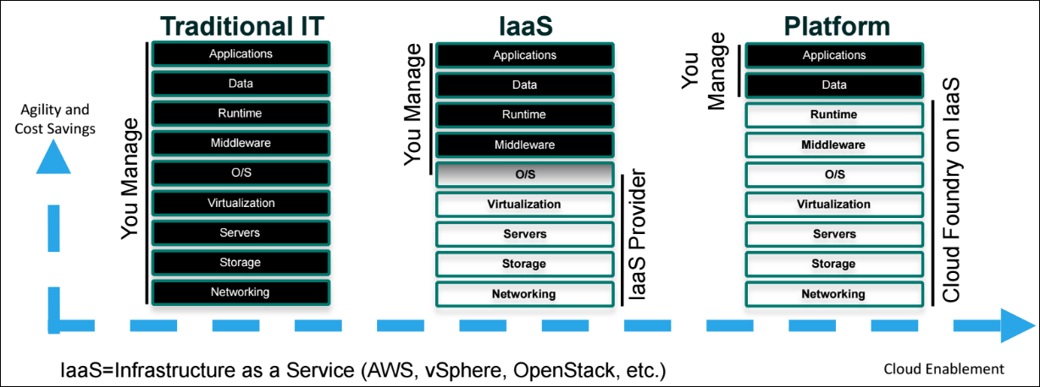
PCF Benefit – You manage applications and data

Slide 12
How Pivotal Cloud Foundry Differs from Open Source Cloud Foundry
Open source software provides the basis for the Pivotal Cloud Foundry platform.
Elastic Runtime is the Pivotal distribution of Cloud Foundry software for hosting apps.
Pivotal offers additional commercial features, enterprise services, support, docs, certs, etc.

Slide 13
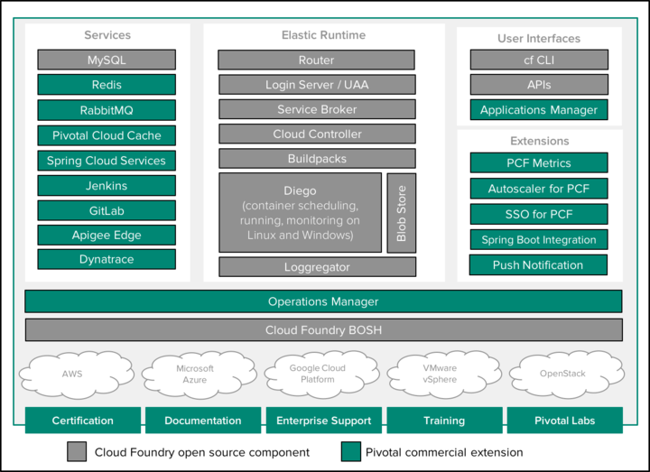
PCF vs Cloud Foundry

Slide 14
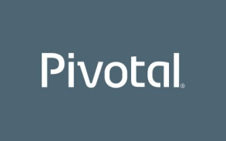


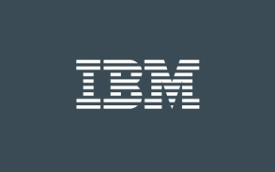


Cloud Foundry –As-A-Service Providers
You can also use a PaaS deployed by a commercial CF cloud provider

Slide 15
PCF Best Practices for App Developers

Slide 16
Avoid Writing to the Local File System
Applications running on Cloud Foundry should not write files to the local file system for the following reasons:
Local file system storage is short-lived.
When an application instance crashes or stops, the resources assigned to that instance are reclaimed
When the instance is restarted, the application will start with a new disk image.
Although your application can write local files while it is running, the files will disappear after the application restarts.

Slide 17
Avoid Writing to the Local File System
Instances of the same application do not share a local file system.
Each application instance runs in its own isolated container.
Thus a file written by one instance is not visible to other instances of the same application. If the files are temporary, this should not be a problem.
However, if your application needs the data in the files to persist across application restarts, or the data needs to be shared across all running instances of the application, the local file system should not be used.
We recommend using a shared data service like a database or blobstore for this purpose.

Slide 18
Avoid Writing to the Local File System
Cloud Foundry service such as the MongoDB document database or a relational database like MySQL or Postgres. Another option is to use cloud storage providers such as Amazon S3, Google Cloud Storage, Dropbox, or Box.
If your application needs to communicate across different instances of itself, consider a cache like Redis or a messaging-based architecture with RabbitMQ.

Slide 19
Cloud Foundry Updates – Implications on your deployed application
For application management purposes, Cloud Foundry may need to stop and restart your application instances. If this occurs, Cloud Foundry performs the following steps:
Cloud Foundry sends a single termination signal to the root process that your start command invokes.
Cloud Foundry waits 10 seconds to allow your application to cleanly shut down any child processes and handle any open connections.
After 10 seconds, Cloud Foundry forcibly shuts down your application.
Your application should accept and handle the termination signal to ensure that it shuts down gracefully.

Slide 20
Run Multiple Instances to increase Availability
When a Diego cell is upgraded, the applications running on it are shut down gracefully, then restarted on another Diego cell .
To avoid the risk of an application being unavailable during a Cloud Foundry upgrade processes, you should run more than one instance of the application.

Slide 21
Digging Deep on Behind the scenes of CF push

Slide 22
App Deploy steps
At the command line, the developer enters the directory containing her application and uses the Cloud Foundry Command Line Interface (cf CLI) to issue a push command.
The cf CLI tells the Cloud Controller to create a record for the application.
The Cloud Controller stores the application metadata. Application metadata can include the app name, number of instances the user specified, and the buildpack, and other information about the application.
Before uploading all the application files, the cf CLI issues a resource match request to the Cloud Controller to determine if any of the application files already exist in the resource cache.
When the application files are uploaded, the cf CLI omits files that exist in the resource cache by supplying the result of the resource match request.

Slide 23
App Deploy steps
The uploaded application files are combined with the files from the resource cache to create the application package.
The Cloud Controller stores the application package in the blobstore.
The cf CLI issues an app start command.
The Cloud Controller issues a staging request to Diego, which then schedules a Cell to run the staging Task.
The Task downloads buildpacks and if present, the app’s buildpack cache. It then uses the buildpack that is detected automatically or specified with the -b flag to build the droplet.

Slide 24
App Deploy steps
The Task packages the resulting staged application into a tarball called a “droplet” and the Diego Cell stores it in the blobstore. The Task also uploads the buildpack cache to the blobstore for use the next time the application is staged.
The Diego Bulletin Board System reports to the Cloud Controller that staging is complete. Staging must complete within 15 minutes or the staging is considered failed. Apps are given a minimum of 1GB memory to stage, even if the requested running memory is smaller.
Diego schedules the application as a Long Running Process on one or more Diego Cells.
The Diego Cells report the status of the application to the Cloud Controller.

Slide 25
App Deploy steps
The Task uses the instructions in the buildpack to stage the application.
The Diego Cell streams the output of the staging process so the developer can troubleshoot application staging problems.
The Task packages the resulting staged application into a tarball called a “droplet” and the Diego Cell stores it in the blobstore. The Task also uploads the buildpack cache to the blobstore for use the next time the application is staged.

Slide 26
App Deploy steps
The Diego Bulletin Board System reports to the Cloud Controller that staging is complete.
Staging must complete within 15 minutes or the staging is considered failed.
Apps are given a minimum of 1GB memory to stage, even if the requested running memory is smaller.
Diego schedules the application as a Long Running Process on one or more Diego Cells.
The Diego Cells report the status of the application to the Cloud Controller.
See the Diego Architecture topic for more information.

Slide 27
Lifecycle of an Application

Slide 28
Deployment
The application deployment process involves uploading, staging, and starting the app in a container.
Your app must successfully complete each of these phases within certain time limits.
The default time limits for the phases are as follows:
Upload: 15 minutes
Stage: 15 minutes
Start: 60 seconds
Developers can change the time limit for starting apps through an application manifest or on the command line.

Slide 29
Crash Events
If an app instance crashes, CF automatically restarts it by rescheduling the instance on another container three times. After three failed restarts, CF waits thirty seconds before attempting another restart.
The wait time doubles each restart until the ninth restart, and remains at that duration until the 200th restart.
After the 200th restart, CF stops trying to restart the app instance.

Slide 30
Evacuation
Certain operator actions require restarting VMs with containers hosting app instances.
For example, an operator who updates stemcells or installs a new version of CF must restart all the VMs in a deployment.
CF automatically relocates the instances on VMs that are shutting down through a process called evacuation.
CF recreates the app instances on another VM, waits until they are healthy, and then shuts down the old instances.
During an evacuation, developers may see their app instances in a duplicated state for a brief period.

Slide 31
Shutdown
When PCF requests a shutdown of your app instance,
either in response to the command cf scale APPNAME -i NUMBER-OF-INSTANCES or
because of a system event, CF sends the app process in the container a SIGTERM.
The process has ten seconds to shut down gracefully.
If the process has not exited after ten seconds, CF sends a SIGKILL.
Apps must finish their in-flight jobs within ten seconds of receiving the SIGTERM before CF terminates the app with a SIGKILL.
For instance, a web app must finish processing existing requests and stop accepting new requests.

Slide 32
Thank You

